Slide 1

Just Fitness
A fitness app that handles what really matters
An app that counts your activities, so you can focus on the important things
Adi Brock - 321018962
Tamir Nahum - 203931639
Evyatar Shalev - 312596026

Slide 2
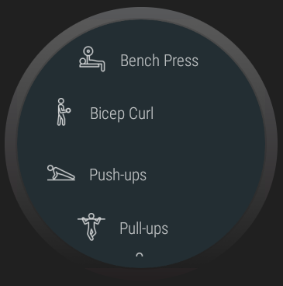
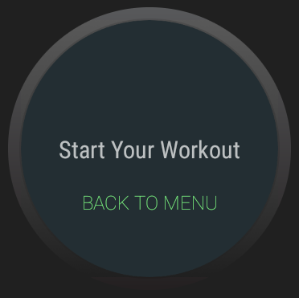
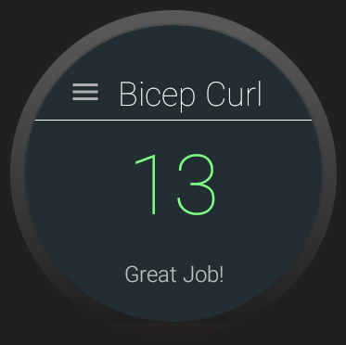
Screenshots:

Slide 3

Demo:

Slide 4
Technical Description:
Gesture detection:
We used the gyroscope of the smart watch.
Sampled the angle in relation to Earth on three axes, into an array.
Every half-second we checked whether the same sample (array) was a gesture.
When we identified a gesture - we added 1 to the counter.

Slide 5
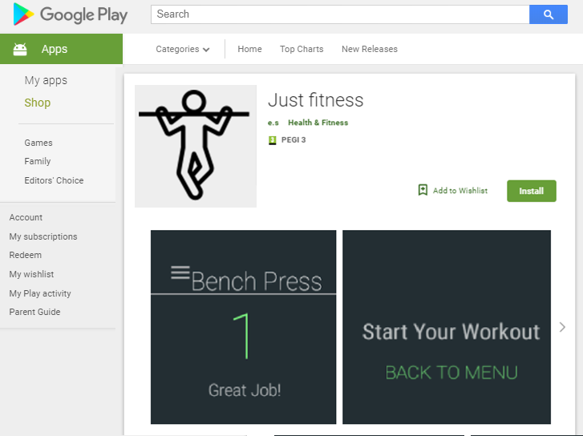
Questions?

